Slide 1
DATA ANALYTICS | WEEK 3 ACTIVITY 2 | YOOBEE COLLEGES
Data Cleaning &
Correlation Analysis
Pearson Algorithm — Linear Correlation Between Features
Dataset: messy_dataset_Mukesh.csv | 10 rows | 6 columns
Cleaned → Analysed → Visualised → Interpreted

Slide 2
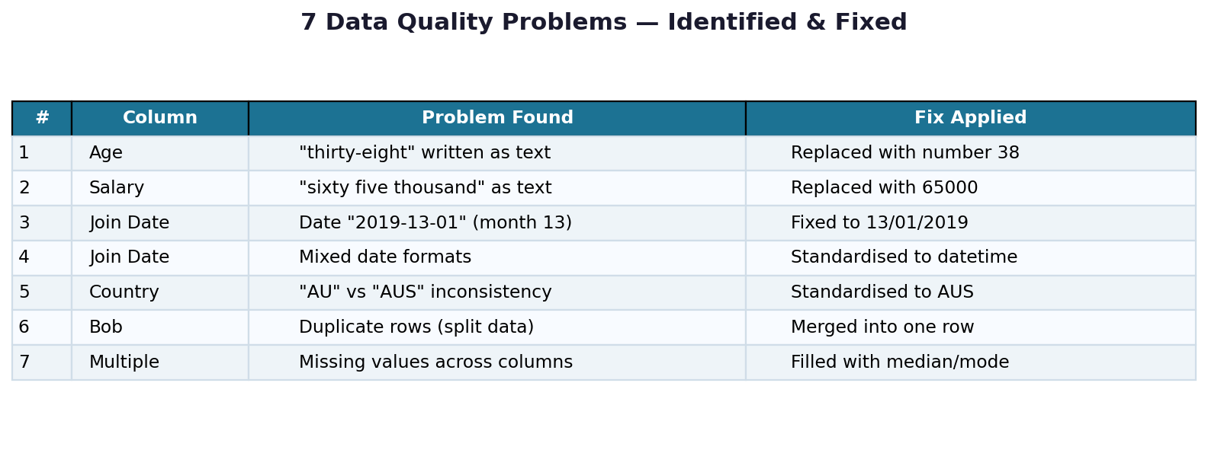
STEP 1 — Load & Identify Problems in the Raw Data
10
6
7
9
Raw Rows
Columns
Problems
Found
Clean Rows
After Fix

Slide 3
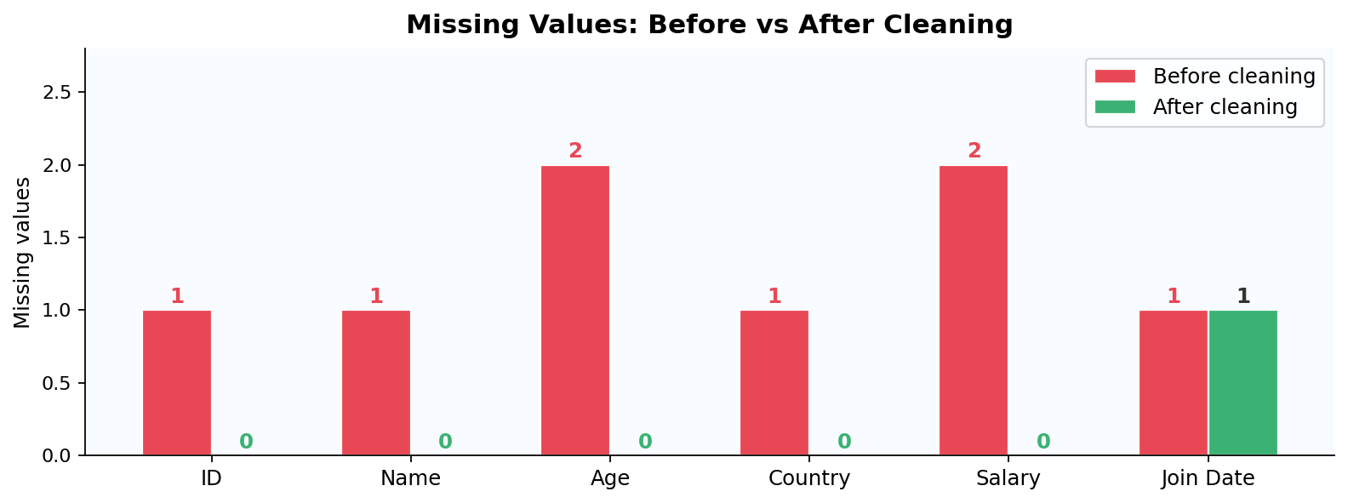
STEP 2 — Data Cleaning Process
Missing Values Before vs After
Cleaning Strategy
Text → Numbers
'thirty-eight' → 38
'sixty five thousand' → 65000
Dates Fixed
Invalid month 13 corrected
Mixed formats standardised
Duplicates Merged
Bob's 2 rows merged into 1
using first non-null values
Missing Filled
Result: 9 clean rows · 0 missing values (except Charlie's unrecoverable join date)
Numeric → median
Country → mode (NZ)

Slide 4
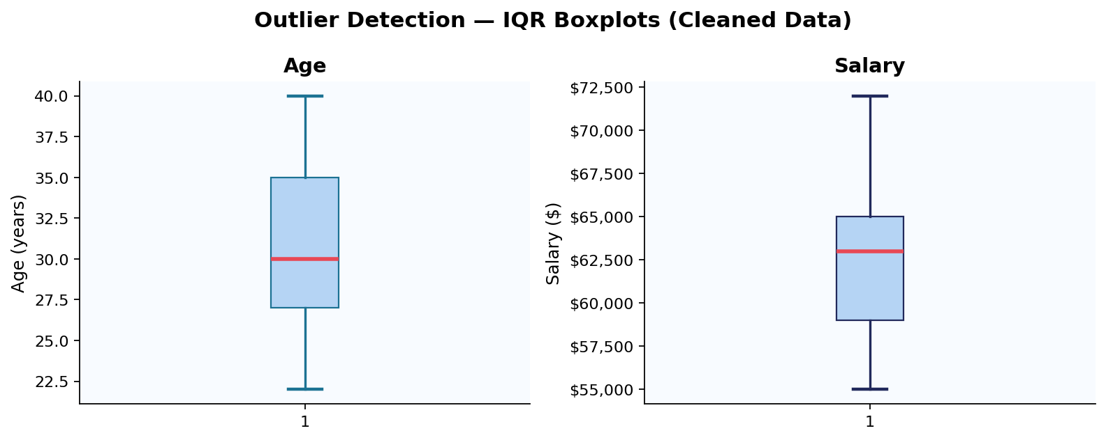
STEP 3 — Outlier Detection Using IQR Method
Age | Q1=25.8 Q3=36.3 IQR=10.5
Salary | Q1=$58.5k Q3=$66k IQR=$7.5k
Bounds: 9.5 – 52.0 → No outliers found
Bounds: $47.3k – $77.3k → No outliers found

Slide 5
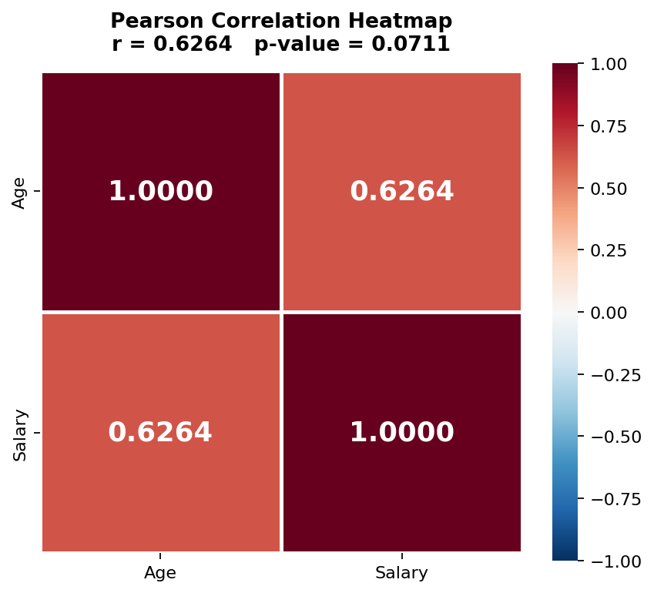
STEP 4 — Pearson Correlation Heatmap
What does r = 0.6289 mean?
r value
p-value
0.6289
0.0696
Moderate positive
linear relationship
Not significant at p<0.05
(small sample)
Direction
Sample
Positive
n = 9
As Age increases,
Salary increases
Small dataset — larger
sample needed
Pearson formula: r = S_xy / (S_x × S_y)
where S_xy = sample covariance, S_x and S_y = standard deviations

Slide 6
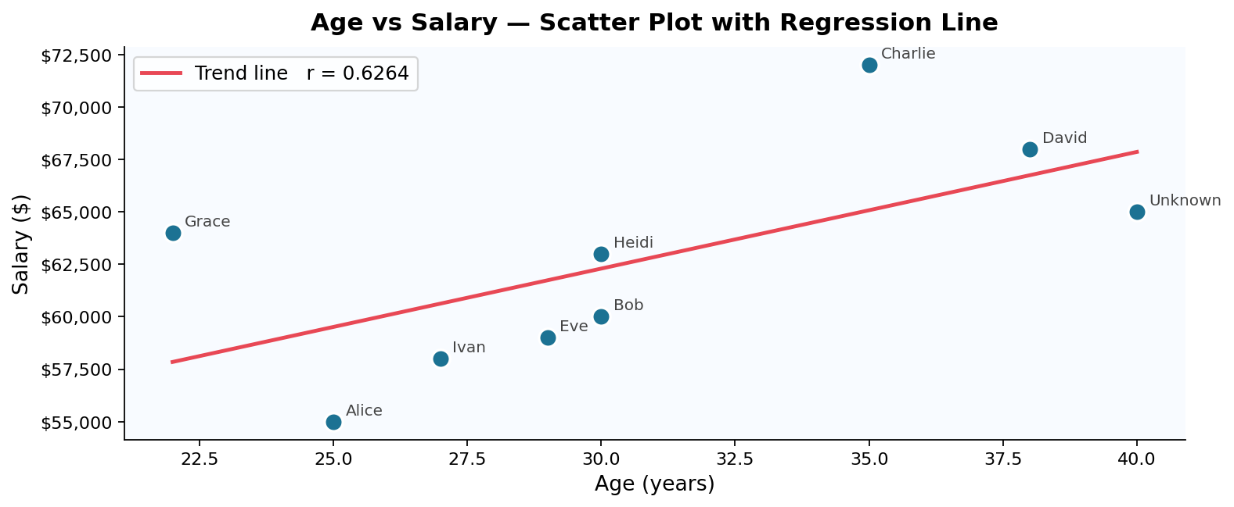
STEP 5 — Visualisation: Age vs Salary Scatter Plot
The red trend line shows a moderate upward slope — older employees tend to earn more, though with some variation (e.g. Grace aged 22 earns $64k, close to Bob aged 30 on $60k).

Slide 7
Summary Story
Week 3 Activity 2 — Data Cleaning & Pearson Correlation Analysis
01
The Raw Data Was Messy
04
A Moderate Correlation Exists
The dataset had 7 distinct problems — text where numbers should be, an impossible date, duplicate rows, inconsistent country codes, and missing values scattered across every column.
Pearson r = 0.6289 shows a moderate positive relationship. Older employees earn more — but the p-value of 0.0696 means we cannot be fully confident with just 9 data points.
02
Cleaning Made It Usable
05
Correlation ≠ Causation
Each problem was fixed systematically: text converted to numbers, invalid date corrected, Bob's duplicate rows merged, country codes standardised, and missing values filled with median and mode.
Age does not directly cause higher salary. Experience, career progression, and seniority are the real drivers. A larger dataset is needed to draw firm conclusions.
03
No Outliers Were Found
06
Data Quality Matters Most
After cleaning, both Age (22–40) and Salary ($55k–$72k) were well within IQR bounds. The data was consistent with no extreme values distorting the analysis.
Without the cleaning steps, the correlation analysis would have failed entirely — text values cannot be correlated. Clean data is the foundation of any reliable insight.
Course: Data Analytics | Yoobee Colleges | 2511-YCCIA-MSE

